Slide 1
Comparing Conceptual, Logical & Physical Models

Slide 2
Feature | Conceptual | Logical | Physical
Entity Names | ✓ | ✓
Entity Relationships | ✓ | ✓
Attributes |  | ✓
Primary Keys |  | ✓ | ✓
Foreign Keys |  | ✓ | ✓
Table Names |  |  | ✓
Column Names |  |  | ✓
Column Data Types |  |  | ✓

Slide 3
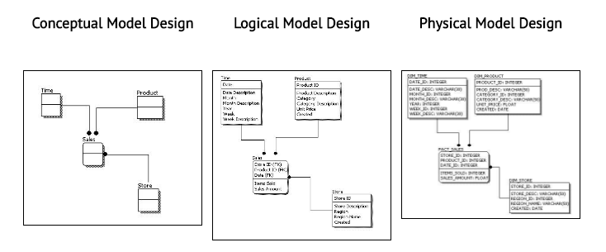
All the Data Models!!!

Slide 4
Conceptual to Logical, And Logical to Physical Models →…..
We can see that the complexity increases from conceptual to logical and from logical to physical.

Slide 5
Summary
This is why we always first start with the Conceptual Model (so we understand at high level what are the different entities in our data and how they relate to one another).
Then move on to the Logical Model (so we understand the details of our data without worrying about how they will actually implemented).
And finally the Physical Model (so we know exactly how to implement our data model in the database of choice).

